Slide 1
Identifying Patients at Higher Risk for Detachment from Diabetes Self-Care
Fall 2024 Data 144/Educ 244
Notes:
Reina
Hello everyone, We are thrilled to present our Project on

Slide 2
Our Team
Ryan Powers
Shirley Sui
Shuran Yang
Yibing (Reina) Ying
Wen Zhang
Notes:
My name is Reina, and I would like to introduce the team

Slide 3
Our Process
01
02
03
04
05
06
Background
Data Selection
Data Preprocessing
Feature Engineering
Modeling
Result
Notes:
Reina

Slide 4
01
Background
Notes:
Reina

Slide 5
—Francis Peabody
“The secret of the care of the patient is in caring for the patient”
Notes:
Reina
We chose this quote because we believe it capture the essence of our project emphasizing that true healthcare goes beyond mere medical treatment and involves genuinely caring for the patient's overall well-being.
At its heart, our project is about putting the human back into healthcare. We're not just looking at numbers and charts - we're trying to understand the whole person behind the diabetes diagnosis. It's like Dr. Peabody said, the real magic of medicine happens when we truly care for our patients.

Slide 6
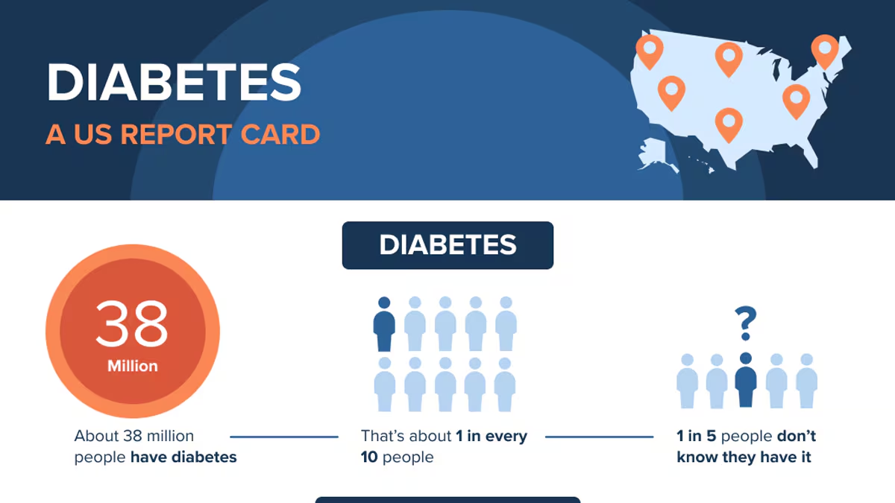
Why these Results matter
With early action, you can reverse prediabetes to prevent or delay type 2 diabetes that affects 1 in 3 US adults.
Around 38 million adults have diabetes, and 1 in 5 of them don't know they have it.
Diabetes is the eighth leading cause of death.
Type 2 diabetes accounts for about 90% to 95% of all diagnosed cases of diabetes; type 1 diabetes accounts for about 5% to 10%.
Diabetes is the No. 1 cause of kidney failure, lower-limb amputations, and adult blindness.
In the last 20 years, the number of adults diagnosed with diabetes has more than doubled.
https://www.cdc.gov/diabetes/about/index.html
Notes:
Reina
Introduction: “Let’s start by understanding the gravity of diabetes in the U.S. While there are 3 types, for the context of this Project we will focus on Type 2.
Type 2 Diabetes Context:
Type 2 diabetes, accounting for 90–95% of all diagnosed cases, is a chronic condition where the body struggles to use insulin effectively.
Key Data: There are currently, around 38 million people live with diabetes, but shockingly, 1 in 5 don’t even know they have it. This delay in diagnosis contributes to severe outcomes, such as kidney failure, limb amputations, and blindness.”
Call to Action: These numbers highlight the urgency for proactive management. Small steps today can prevent lifelong challenges tomorrow.
—-
It’s linked to lifestyle factors like poor diet, inactivity, and obesity, but genetics also play a role. Key risks include being overweight, having a family history, or belonging to certain ethnic groups. Complications, such as heart disease, kidney failure, and blindness, make it critical to manage effectively. Early action—through healthy eating, exercise, and weight management—can prevent or delay its onset.
—--
Did you know that 1 in 3 adults is at risk of developing type 2 diabetes?
• Key Data: There are currently, around 38 million people live with diabetes, but shockingly, 1 in 5 don’t even know they have it. This delay in diagnosis contributes to severe outcomes, such as kidney failure, limb amputations, and blindness.”
• Call to Action: These numbers highlight the urgency for proactive management. Small steps today can prevent lifelong challenges tomorrow.
Citation:
https://www.cdc.gov/diabetes/prevention-type-2/index.html
https://www.cdc.gov/diabetes/about/index.html

Slide 7
Addressing Patient Apathy in Diabetes Management
The Challenge:
Diabetes affects over 10% of the population.
Self-management is crucial but often challenging.
Patient apathy significantly impacts successful management.
Our Approach:
Develop a predictive machine learning model using NHANES data.
Identify high-risk individuals for self-care detachment.
Determine key factors contributing to patient apathy
Impact:
Medical costs for people with diabetes are more than twice as high as for people who don't have diabetes.
Medical costs and lost work and wages for people with diagnosed diabetes total $413 billion yearly.
Notes:
Reina
Ryan 45sec
The Challenge: One of the biggest hurdles is patient apathy. Apathy refers to a lack of motivation in managing diabetes, seen in inconsistent medication use, missed doctor visits, or failure to follow lifestyle recommendations. It’s driven by factors like depression, burnout, lack of awareness, socioeconomic challenges, and feeling overwhelmed by daily disease management.
Even with awareness, many struggle with consistent self-management, which is critical for controlling diabetes effectively.
• Innovative Approach: To tackle this, we’re leveraging data from NHANES to build predictive models. These models can help us identify individuals at risk of disengagement, so we can intervene early and effectively.
• Economic Impact: And let’s not forget the financial toll. With over $413 billion spent annually on diabetes-related healthcare and productivity losses, addressing this challenge isn’t just about health—it’s about sustainability.

Slide 8
Research Question & Stakeholders
Our research questions:
Can we predict high-risk patients using machine learning?
What are the most significant factors contributing to patient apathy in diabetes management?
How can we translate insights into actionable strategies?
Our primary stakeholders:
Healthcare providers: Will enhance their ability to identify high-risk patients early and provide targeted support.
Patients: Improved prediction and personalized care strategies for better health outcomes and quality of life.
Public health officials and policymakers: Inform resource allocation and community-level interventions.
Health insurance companies: More cost-effective care strategies.
Researchers: Broader understanding of patient behavior in chronic disease management.
Notes:
Reina
Ryan 45 sec
Framing the Research: “We’re focusing on three critical questions: First, can we use machine learning to predict which patients are at risk? Second, what drives patient apathy in diabetes care? And third, how can we transform these insights into actionable strategies?”
Our key stakeholders are healthcare providers, patients, policymakers, health insurance companies,and researchers.
•Key Stakeholders: This research has broad implications. Healthcare providers can target support where it’s needed most. Patients benefit from tailored strategies that improve their quality of life. Policymakers can optimize resource allocation, while insurers find more cost-effective solutions. Finally, researchers gain a deeper understanding of diabetes-related behaviors.
•Call to Collaboration: By addressing these questions and collaborating with stakeholders, we can move closer to a future where diabetes is manageable for all.
Our project aims to use machine learning to identify patients at risk of detachment from self-care, with high hopes that our results could enable healthcare providers, patients, families, policy makers to offer a more personalized and effective careplan. By focusing on understanding the factors that contribute to patient disengagement, we are essentially finding new ways to "care for the patient" in the context of diabetes management.

Slide 9
02
Data Selection
Notes:
Ryan (5 sec)

Slide 10
National Health & Nutrition Examination Survey (NHANES)
Background…
https://www.cdc.gov/nchs/nhanes/about_nhanes.htm
Began in the early 1960s as a survey
Ongoing since 1999 as a continuous program including objective measurements in addition to the original surveys
Nationally representative sample, ~5000 individuals each year
Survey: demographic, socioeconomic, dietary, and health-related questions
Measurements: medical, dental, and physiological measurements, as well as laboratory tests
Harmonized NHANES
https://pmc.ncbi.nlm.nih.gov/articles/PMC9934713/
Combined data from 1988-2018
Preliminary cleaning and correction of inconsistencies in data/variable coding across 3 decades of data collection
Notes:
Ryan (30 sec)
For our data selection process for our study. ​ We utilized the National Health & Nutrition Examination Survey (NHANES), from the CDC which has been ongoing since 1999 and provides a nationally representative sample of around 5,000 individuals each year. This survey includes demographic, socioeconomic, dietary, and health-related questions, along with medical, dental, and physiological measurements. ​ We also used the Harmonized NHANES data, which combines data from 1988 to 2018, ensuring consistency across three decades. ​ totaling 135,310 participants and 5,078 variables
• The multiple datasets were categorized and separated into demographics, dietary data, physiological measures, occupational details, questionnaire responses, medication use, mortality, survey weights, and environmental exposure biomarkers.
Next slide

Slide 11
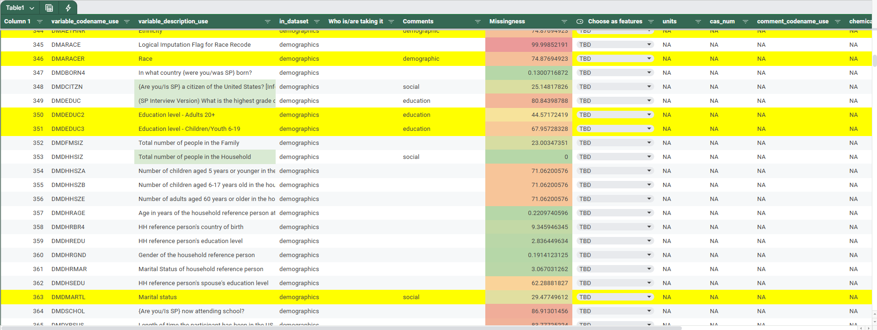
Data Dictionary (theirs)
The data source…
8 distinct datasets: chemicals, demographics, dietary, medications, mortality, occupation, questionnaire, response
Examined data dictionary provided by Nguyen et al. for potentially relevant variables & their missingness, commenting on relevance for further exploratory data analysis
Notes:
Ryan (30sec)
As you can see here
We examined the data dictionary provided by Nguyen et al. ​ to identify relevant variables and their missingness. ​ For our analysis, we narrowed down the original 10 datasets to selected few focusing on demographics, dietary habits, medications, occupation, and questionnaires, excluding mortality data."

Slide 12
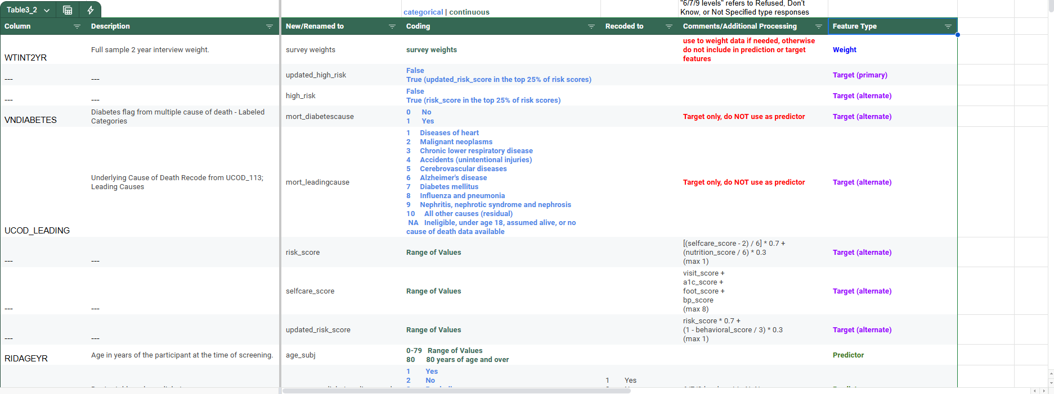
Data Dictionary (ours)
The data sets…
Selected datasets: demographics, dietary, medications, mortality, occupation, questionnaire
We did not end up using mortality (originally considered as potential target features)
Constructing our own data dictionary…
Essential for proper data cleaning and analysis
How data was coded
Differentiation between categorical and continuous data
Notes:
Shirley (~17 sec)
Based on our examination of the available data, we narrowed down the datasets we wanted to work with to the 6 listed here.
As we worked through the data cleaning, we also created and updated our own data dictionary to track important information about each selected feature. This helped with managing the data throughout the cleaning and modeling processes.

Slide 13
03
Data Preprocessing

Slide 14
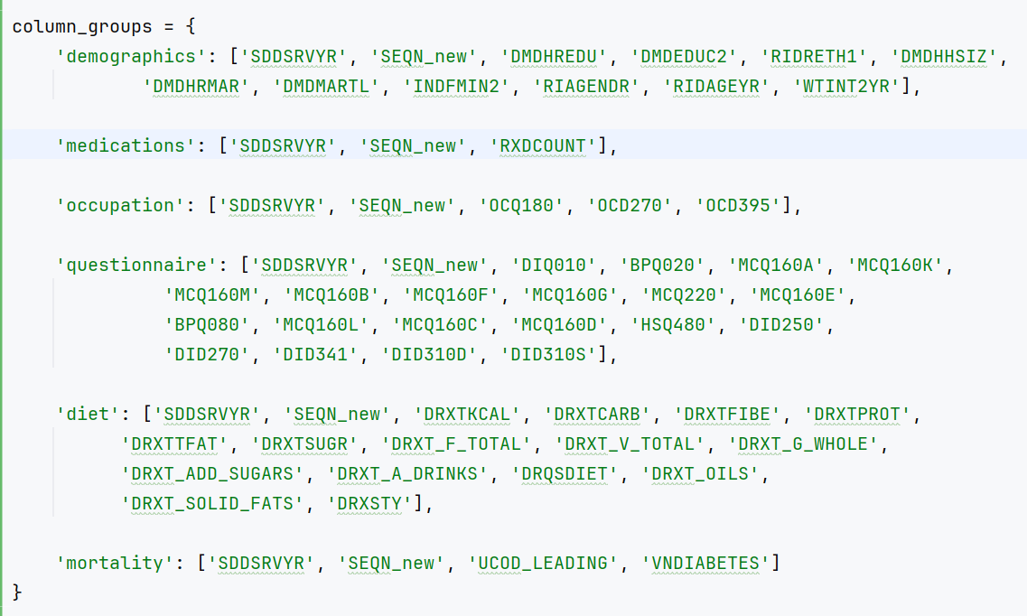
Feature Selection(before)
Examine Missingness
examine_missing analyzes missing values across the entire dataset
percent_missing checks missing values
Select Columns
demographics_cols: 12
medications_cols: 3
occupation_cols: 5
questionnaire_cols: 22
diet_cols:
Core nutritional indicators: 6
Food groups:5
Behavioral indicators: 'DRQSDIET'
Quality indicators: 3
mort_cols: 4
Notes:
Shirley (~16 sec)
As mentioned earlier, one of the first things we did was examine and drop features that had a high level of missingness (> 85%) utilizing a custom “examine_missing” function.
We then selected columns from each dataset based on what we felt were potentially good predictors for risk of detachment from self care.

Slide 15
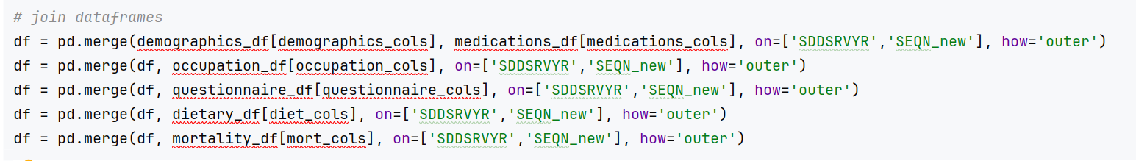
Merging
Merge Dataframes
'SDDSRVYR' represents the release cycle/survey year
'SEQN_new' is the personal ID
The combination of these two fields uniquely identifies a participant's record in a specific survey cycle.
Notes:
Shirley (~12 sec)
We imported the selected features from each dataset and merged everything into one dataframe for further cleaning and feature engineering. This was done on two variables representing the release cycle (or survey year) and the subject ID.

Slide 16
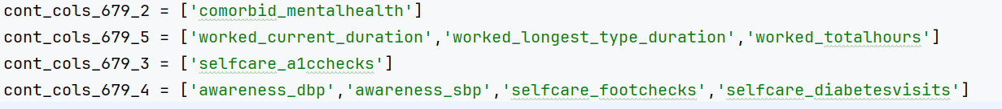
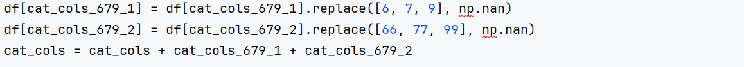
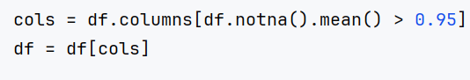
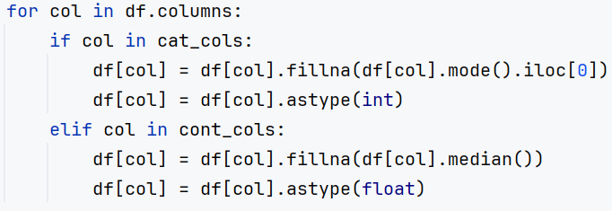
General Data Cleaning
Define variables by type: Categorical vs Continuous, with or without 6/7/9 levels (example)
Handle missing value codes : set any 6/7/9 levels to nan then collapse back into main groups (example)
Retain high-quality data columns (>95%) and fill remaining missing values (example)
Notes:
Shirley (~17 sec)
After merging, we identified questions with “Don’t Know” or “Refuse to answer” -type responses, which were selected and replaced with NA.
We then selected columns with <5% missing data and imputed using median for continuous data and mode for categorical data.

Slide 17
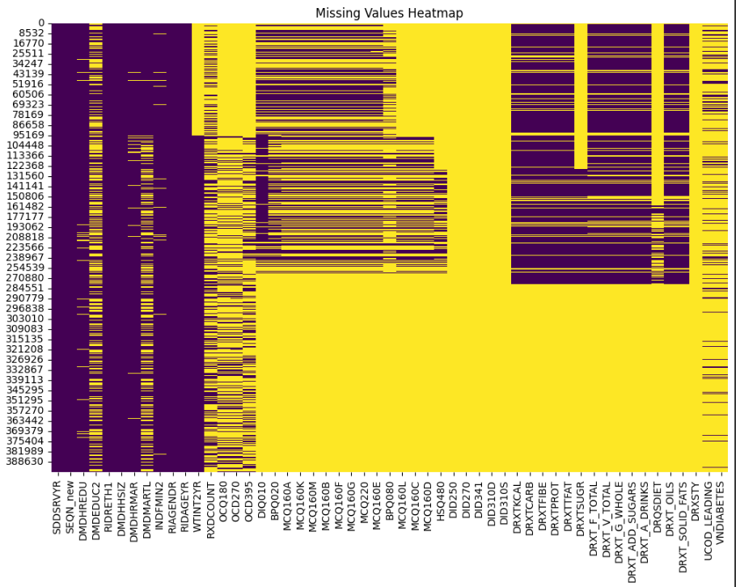
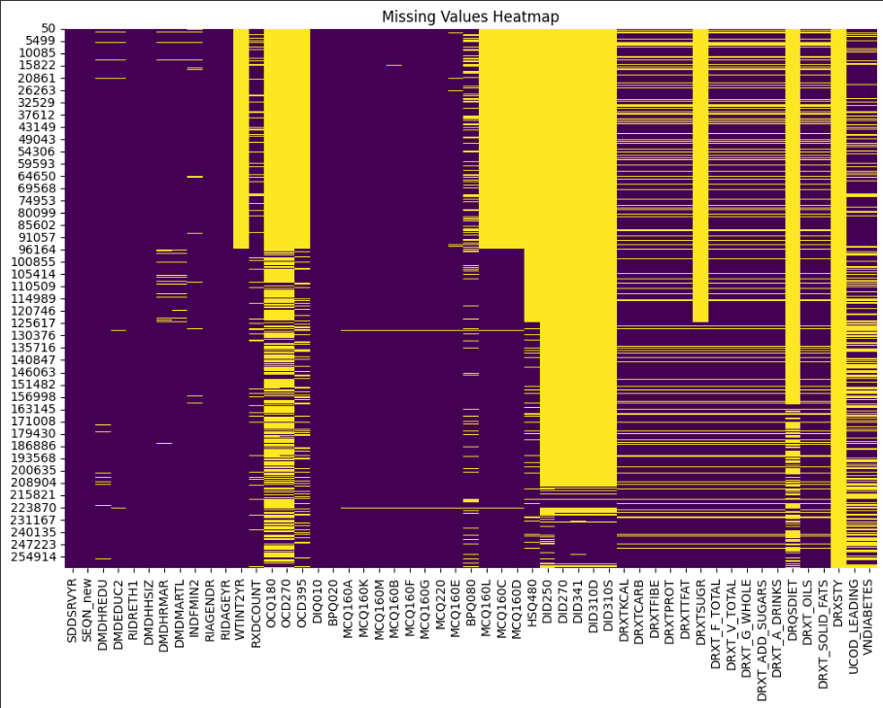
BEFORE
AFTER
Drop duplicates
Delete duplicate rows in the data based on the two columns 'SDDSRVYR' and 'SEQN_new'
Filter data
filter to only subjects with diabetes or borderline, df_full[df_full['DIQ010'].isin([1, 3])]
filter to only adults, ['RIDAGEYR'] >= 18
Notes:
Shirley (~34 sec)
Finally, we removed duplicate rows based on the release cycle and id variables.
We then filtered the data to keep only adults (age > 18) who were told they were diabetic or borderline by their doctor. This is because part of our goal was to examine individual risk factors for detachment from self care, which is less applicable for children (who often depend on adults) and not applicable for non-diabetics. The resulting dataframe was exported to .csv for easy access.
As seen on this slide, we did a decent job with data cleaning, but not all missingness was addressed. Some of this will be addressed during feature engineering.

Slide 18
04
Feature Engineering

Slide 19
Predictors
Notes:
Shirley

Slide 20
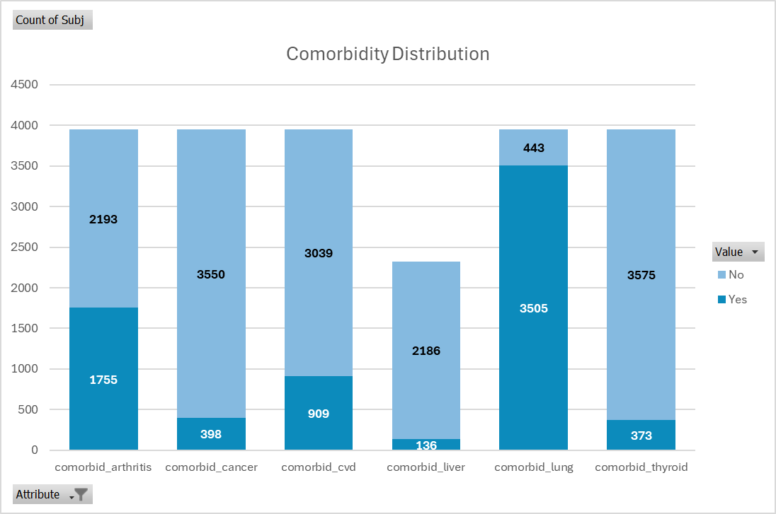
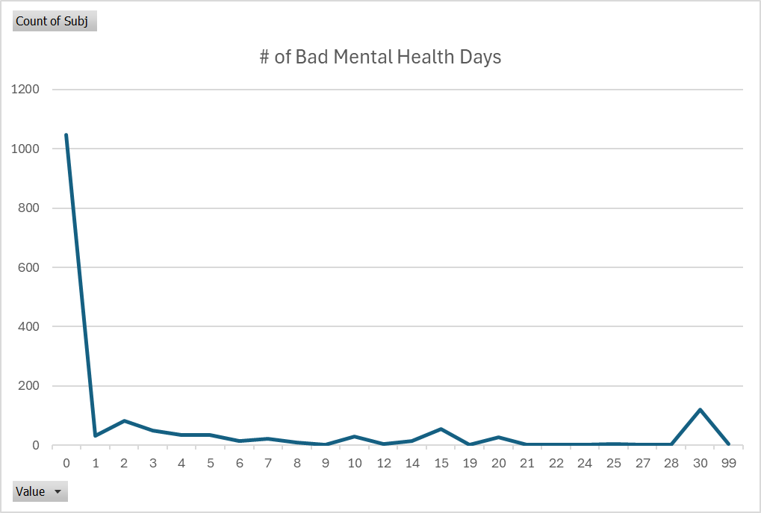
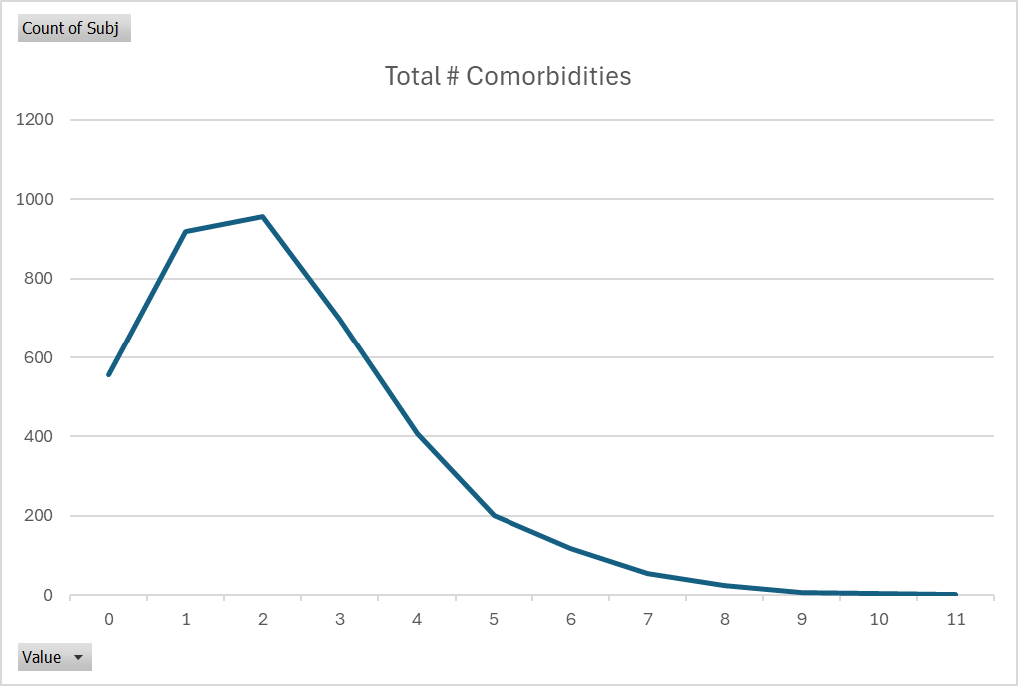
Create Feature - Comorbidities
Aggregated comorbidities into categories where possible, then dropped the related individual comorbidities
comorbid_total: Total number of comorbidities experienced by the individual
Used all comorbidities with <60% missing data; none were dropped after creating this feature
comorbid_cvd: Yes (1) if the individual has at least one cardiovascular disease related comorbidity
cmorbid_angina, comorbid_chd, comorbid_chf, comorbid_cholesterol, comorbid_hypertension, comorbid_mi, comorbid_stroke - these were dropped after creating this feature
comorbid_lung: Yes (1) if the individual has at least one lung related comorbidity
comorbid_chronicbronchitis, comorbid_emphysema - these were dropped after creating this feature
Notes:
Shirley (~43 sec)
We wanted to include data on comorbidities (presence of diseases or conditions other than diabetes), but there were too many features containing this data. The main thing we did in terms of predictor feature engineering was consolidate some of these features into 3 new ones:
comorbid_total represents the total number of individual comorbidities present in each individual
comorbid_cvd represents whether an individual had at least one of 7 cardiovascular disease-related comorbidities. The individual ones were then dropped.
comorbid_lung represents whether an individual had at least one of 2 lung disease-related comorbidities; these individual ones were then dropped.
The graphs shown on this slide depict the distribution of the final set of comorbidity features.

Slide 21
Target
Notes:
Wen

Slide 22
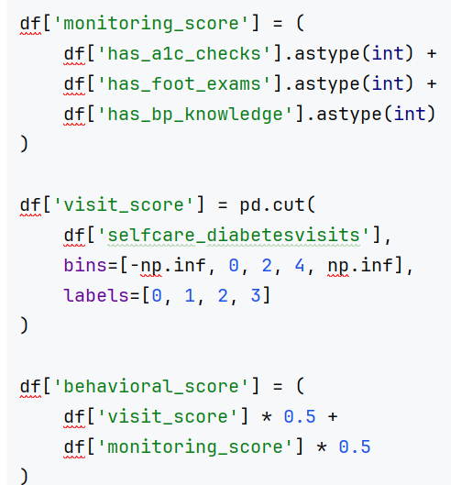
Create Feature - Behavioral score
Measuring patients’ regularity of medical behavior
knowledge_barrier: Quantify the patient's lack of knowledge by counting the number of occurrences
visit_category: Classify the number of visits to the doctor: no visit (0), low frequency (1-2), regular (3-4), and frequent (>4)
has_regular_visits: Determine whether the number of visits to the doctor is within the ideal range (2-4 times).
has_a1c_checks: Mark whether the patient has undergone an A1C check(T/F).
has_foot_exams: Mark whether the patient has undergone a foot examination(T/F).
has_bp_knowledge: Mark whether the patient understands the blood pressure target value(T/F).
Create behavioral_score
Key Findings：
Regular/Frequent visits dominate (74.57%)
Very low participation in self-care behaviors (all <10%)
Most patients (93.17%) report no knowledge barriers
Notes:
Wen

Slide 23
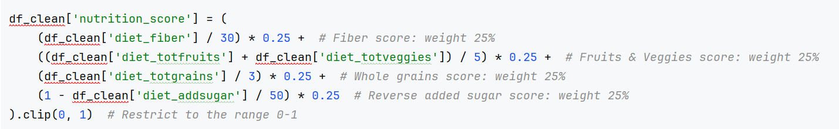
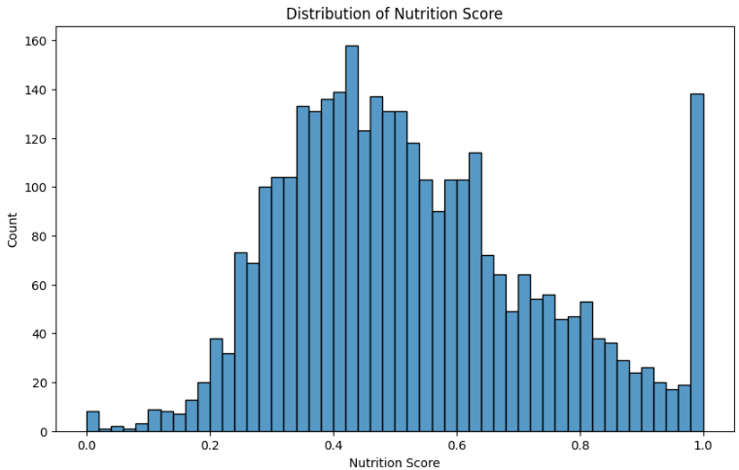
Create Feature - Nutrition score
Measuring patients’ eating behaviors and nutritional management abilities
healthy_eating_score: Measures whether dietary intake is close to the recommended healthy standard
carb_ratio: The proportion of carbohydrates in total daily calories
protein_ratio: The proportion of protein in total daily calories
fat_ratio: The proportion of fat in total daily calories
diet_pattern: Dietary patterns: "poor", "moderate" and "healthy" according to the nutrition score
Calorie intake: a slight right skew and some higher intake
Carbohydrates: strongly correlated with calorie intake, indicating it's the main calorie source
Fiber intake: lower than the recommended value, and strongly affects the nutrition score (correlation 0.761).
Fruit and vegetable: slightly below recommendations
Notes:
Wen

Slide 24
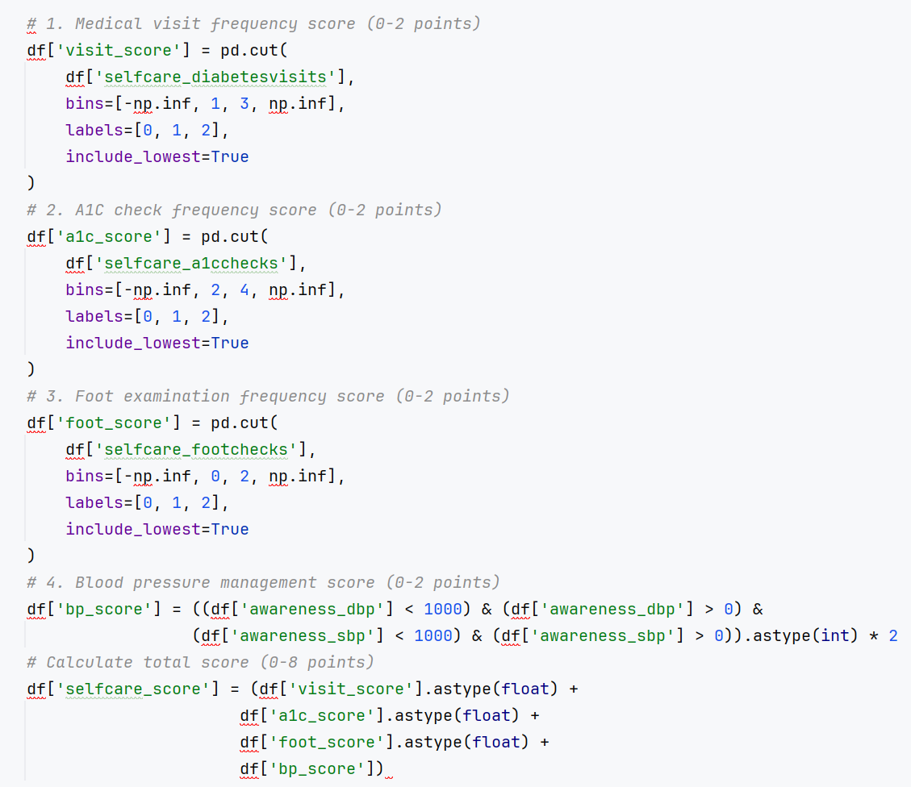
Create Feature - Selfcare score
Measure patients' self-management ability and health awareness level:
Frequency of medical visits (selfcare_diabetesvisits)
A1C check frequency (selfcare_a1cchecks)
Foot examination frequency (selfcare_footchecks)
Awareness of blood pressure management
(awareness_dbp)
(awareness_sbp)
Key Findings:
Self-care scores are concentrated at a medium level (about 4-5 points)
The higher the education level, the higher the self-care score tends to be
Self-care scores are negatively correlated with household size
Gender has little effect on self-care scores
Notes:
Wen

Slide 25
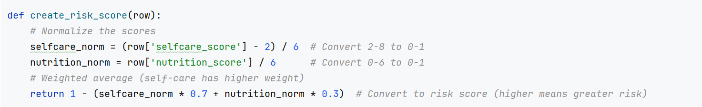
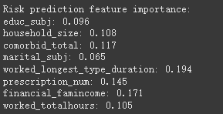
Target: Diabetes Management Indicators
Risk Score: Identify high-risk groups for apathy or detachment from diabetes management
Use quantile(0.75) as the threshold for high risk score, define top 25% as high risk group
Using random forest model to predict high risk group
High-Risk Group Pattern:
Mean risk score: 0.76
Household size: 2-7 members
Prescription count: 2-6 prescriptions
Comorbidities: 2-3 on average
Correlations:
Negative: Prescription count (-0.31), comorbidities (-0.19)
Positive: Household size (0.11), marital status (0.03)
Education & Married: Lower education levels and being married are associated with higher risk
Notes:
Wen

Slide 26
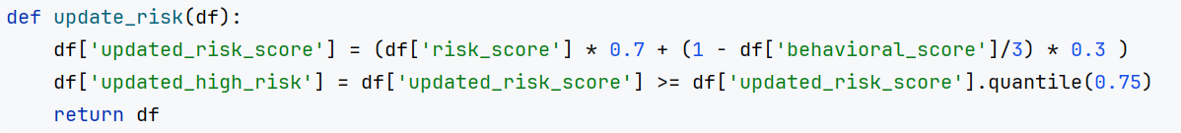
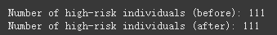
Create updated_risk_score
Integrate behavioral_score into risk_score to create updated_risk_score
WHY: Risk assessment not only considers past risks, but also captures the individual’s current behavioral characteristics
Compare old_hight_risk vs new_hight_rick
Decrease risk scores: the overall risk score dropped from 0.6443 to 0.6049, but increased the variability
No change in high-risk individuals: the number of high-risk individuals (111) remained the same
Impact on low to medium-risk individuals: shake down the percentage of medium-risk individuals, better for future model training
Notes:
Wen

Slide 27
Feature Selection & Export
Notes:
Shirley

Slide 28
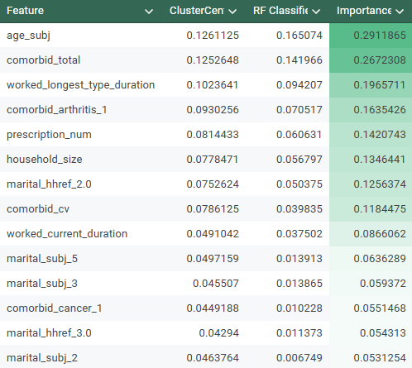
Feature Selection
Target Feature
Updated_high_risk (primary)
Use Cluster Center and RF Classifier to identify important feature
Predictor Feature
Demographic: Age_subj, gender_subj, race_eth, household_size
Education Level: educ_hhref, educ_subj
Marital status: marital_hhref, marital_subj
Work: worked_current_duration, worked_longest_type_duration, worked_totalhours
Health/Medical: Awareness_diabetes_diagnosed, prescription_num, knowledge_barrier Including Comorbidities: comorbid_arthritis, comorbid_cancer, Comorbid_cvd, comorbid_liver, comorbid_lung, comorbid_mentalhealth, comorbid_thyroid, comorbid_total
Financial status: financial_famincome
Notes:
Shirley (~14 sec)
We tried to further reduce our feature set through preliminary modeling to extract feature importance, dropping those with very low feature importance based on both KMeans clustering and Random Forest classifier models. The resulting predictors we selected are shown here.

Slide 29
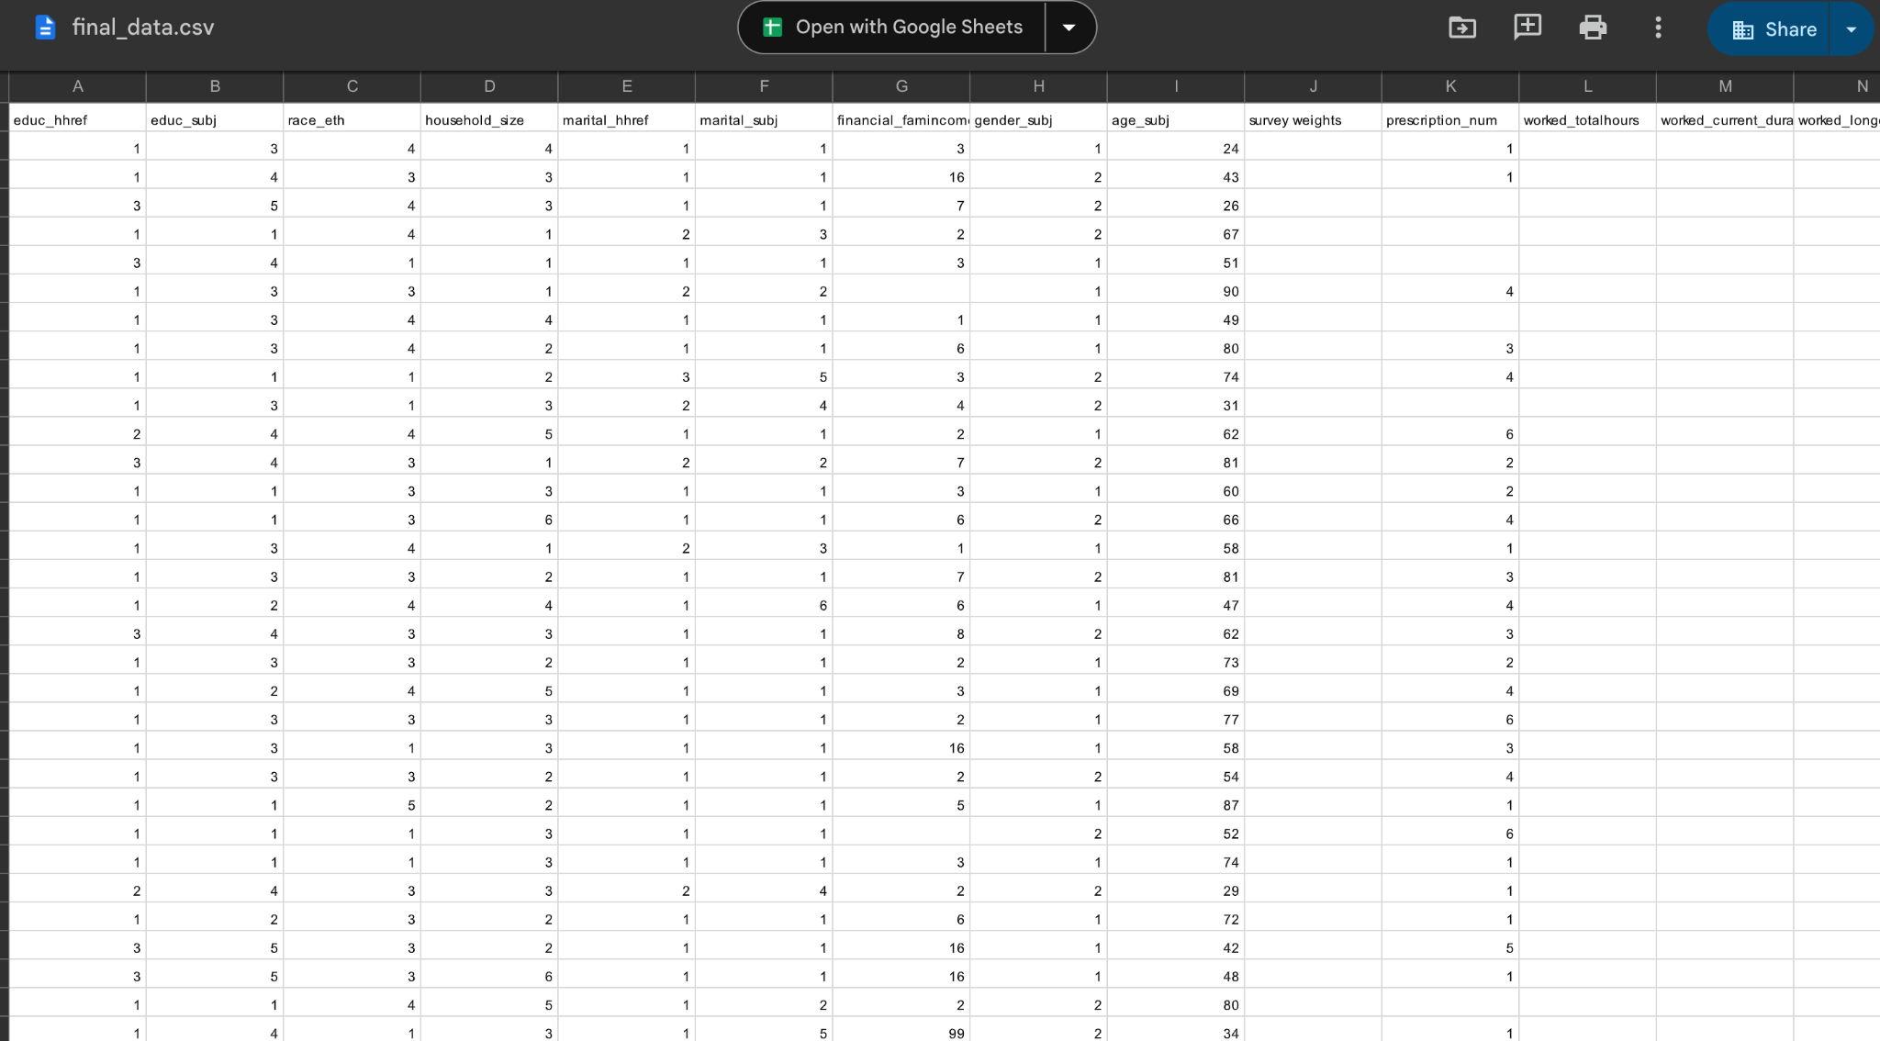
Export final_data.csv
Notes:
Shirley (~4 sec)
The final dataset was then exported to csv for modeling.

Slide 30
05
Modeling
Notes:
SY

Slide 31
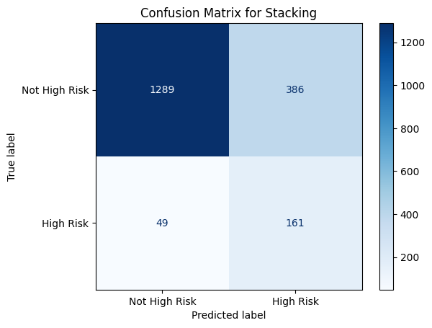
Best Result
Goal
Optimizing Stacked Model for Imbalanced Data
Recall: 0.77 for both class 1 and class 0
Key Steps:
Combine predictions from base models (e.g., LightGBM and Random Forest).
Train a Logistic Regression meta-model optimized for recall.
Use GridSearchCV to tune hyperparameters for better recall.
Chose recall as main evaluation metric: suitable for predicting high-risk cases for healthcare intervention
Visualize ROC and perform k fold cross validation to evaluate the model
Notes:
SY
Recall = TP/(TP+FN)
In this case, it measures the proportion of actual diabetes patients (positives).
Because Our purpose is to identify patients who are at risk of not properly managing their diabetes at home
A high recall ensures that most patients with diabetes are correctly flagged by our model, even if it means also flagging some individuals who don't have diabetes (increasing false positives).

Slide 32
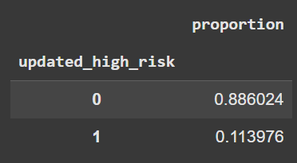
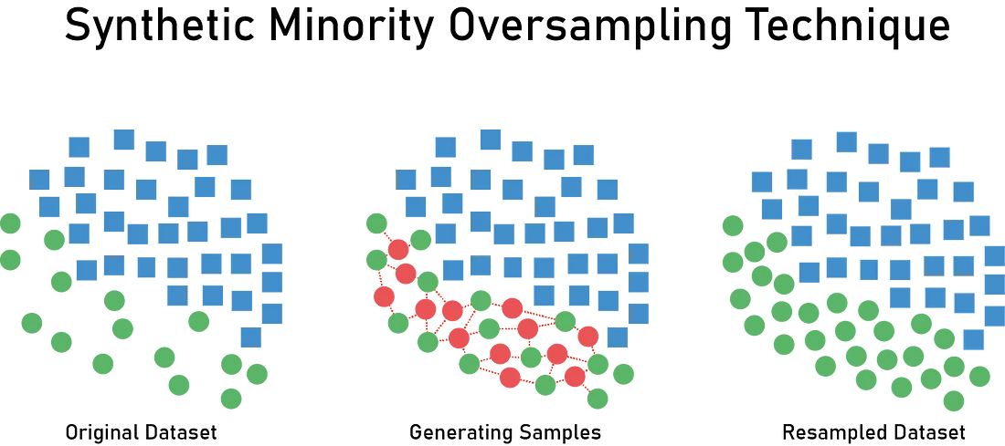
Data Resampling and SMOTE
Oversampling class 1 using SMOTE (Synthetic Minority Oversampling Technique).
Undersampling the class 0.
Imbalance Data:
Class 1 (high risk) / Class 0 is ~1/9
Reference: https://emilia-orellana44.medium.com/smote-2acd5dd09948
Notes:
SY
Highlight that the dataset is significantly imbalanced, with only ~11% of the instances belonging to the high-risk class (Class 1) and 89% to the low-risk class (Class 0).
Mention why this is an issue: imbalanced data can cause the model to favor the majority class, leading to poor recall for the minority class.
Explain SMOTE (Synthetic Minority Oversampling Technique):
SMOTE generates synthetic examples for the minority class by interpolating between existing data points.
Use the visual diagram on the slide to explain:
Left: Imbalanced dataset with very few minority samples (green).
Middle: SMOTE generates synthetic samples along the line segments connecting minority samples.
Right: The dataset becomes more balanced, aiding the model.
Briefly mention that along with oversampling the minority class, undersampling the majority class can be used to prevent the dataset from becoming excessively large and to balance the classes more effectively.

Slide 33
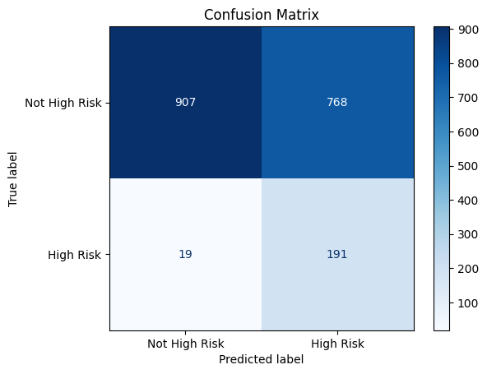
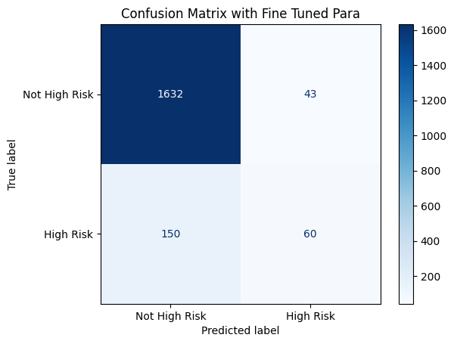
Individual Result of Light GBM and RF
precision recall f1-score support
0 0.92 0.97 0.94 1675
1 0.58 0.29 0.38 210
accuracy 0.90 1885
weighted avg 0.88 0.90 0.88 1885
precision recall f1-score support
0 0.98 0.54 0.70 1675
1 0.20 0.91 0.33 210
Notes:
SY
LightGBM Light Gradient Boosting Machine has parameters like scale_pos_weight to improve performance.
LightGBM's leaf-wise splitting approach excels at making precise predictions on complex patterns.
Robustness: Random Forest is less sensitive to noisy data and overfitting due to averaging across multiple decision trees.
Non-linear Relationships: It captures non-linear relationships between predictors (e.g., comorbid_cvd and knowledge_barrier) effectively.
Diversity in Prediction: Random Forest uses a different tree-building approach (bagging instead of boosting), introducing diversity in predictions.
Observation: LightGBM has high precision for the "Not High Risk" group but struggles with recall for this class, indicating many false negatives. Conversely, for "High Risk," it captures most actual cases (high recall) but at the expense of precision, meaning it misclassifies many "Not High Risk" cases as "High Risk."
Observation: Random Forest performs very well on "Not High Risk," achieving both high precision and recall. However, for "High Risk," it performs poorly, with low recall indicating many missed high-risk patients.
Index(['age_subj', 'awareness_diabetes_diagnosed', 'comorbid_arthritis',
'comorbid_cancer', 'comorbid_cvd', 'comorbid_liver', 'comorbid_lung',
'comorbid_mentalhealth', 'comorbid_thyroid', 'comorbid_total',
'educ_hhref', 'educ_subj', 'financial_famincome', 'gender_subj',
'household_size', 'knowledge_barrier', 'marital_hhref', 'marital_subj',
'prescription_num', 'race_eth', 'worked_current_duration',
'worked_longest_type_duration', 'worked_totalhours'],
dtype='object')

Slide 34
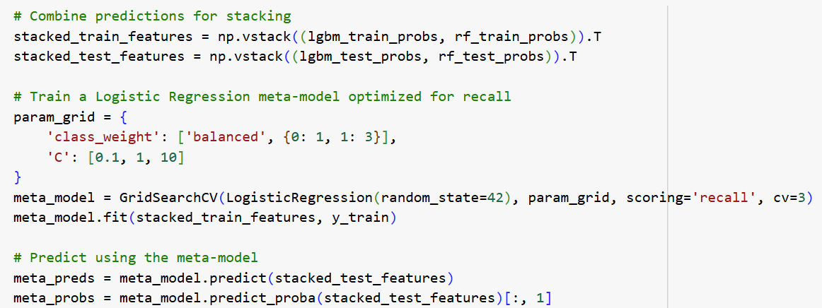
Ensemble Method
Target Feature
Updated_high_risk
Random Forest, LightGBM, Stacking
Each model use GridSearch to fine tune hyperparameters
Predictor Feature
Age
Awareness of Diabetes Diagnosed
Comorbidities
Education Level
Financial Status and Family Income
Gender
Household Size
Knowledge Barrier
Marital
Prescription Number
Race
Work Hours
Notes:
SY
ON THE RIGHT:
Target
The goal was to predict the Updated_high_risk label (patients at risk of poor diabetes management).
Age, comorbidities, and socioeconomic factors were included to account for various determinants of diabetes management.
Index(['age_subj', 'awareness_diabetes_diagnosed', 'comorbid_arthritis',
'comorbid_cancer', 'comorbid_cvd', 'comorbid_liver', 'comorbid_lung',
'comorbid_mentalhealth', 'comorbid_thyroid', 'comorbid_total',
'educ_hhref', 'educ_subj', 'financial_famincome', 'gender_subj',
'household_size', 'knowledge_barrier', 'marital_hhref', 'marital_subj',
'prescription_num', 'race_eth', 'worked_current_duration',
'worked_longest_type_duration', 'worked_totalhours'],
dtype='object')
Random Forest and LightGBM were trained individually.
Their predictions were combined and used in a stacking framework to create a meta-model.
Hyperparameters for each base model were optimized using GridSearchCV to maximize performance.
Use logistic regression as metal model
The stacking meta-model (Logistic Regression) was specifically optimized for recall, ensuring most high-risk cases are captured.

Slide 35
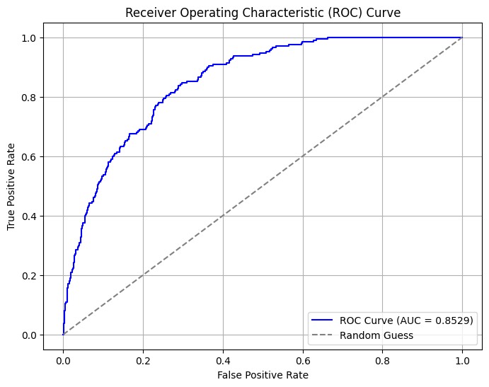
ROC Curve
Strengths:
The model demonstrates strong ability to detect "High Risk" cases (AUC = 0.85 and recall = 0.77).
Weakness:
The high number of False Positives (low precision) could lead to inefficiency in downstream applications.
Challenges:
F1 Score shows an improvement of 0.11 but still limited due to the class imbalance.
Trade-offs between recall and precision make it hard to reach a ‘perfect’ model.
But overall satisfies our purpose of identifying patients with high risk of not properly managing their diabetes at home.
Notes:
SY
AUC shows how the TP change with FP
The model demonstrates strong predictive capability with an AUC (Area Under the Curve) of 0.85:
This shows the model performs significantly better than random guessing (AUC = 0.5).
It indicates a good balance between sensitivity (true positive rate) and specificity (true negative rate) across different thresholds.
A recall of 0.77 (77%) highlights the model’s ability to identify most high-risk cases:
Interpretation: Out of all the patients who are truly at high risk, the model identifies 77%.
Trade-off between recall and precision:
Improving recall (identifying more true positives) increases false positives, reducing precision. Conversely, prioritizing precision could miss some high-risk patients (reducing recall).
Synthetic Samples:
SMOTE may introduce borderline or noisy data points, potentially confusing the model.
Overall: The model effectively identifies high-risk diabetes patients, fulfilling its primary purpose.
However, the high false positive rate could lead to inefficiencies. This may be acceptable depending on the context (e.g., in healthcare, false positives are less harmful than missing actual high-risk cases).

Slide 36
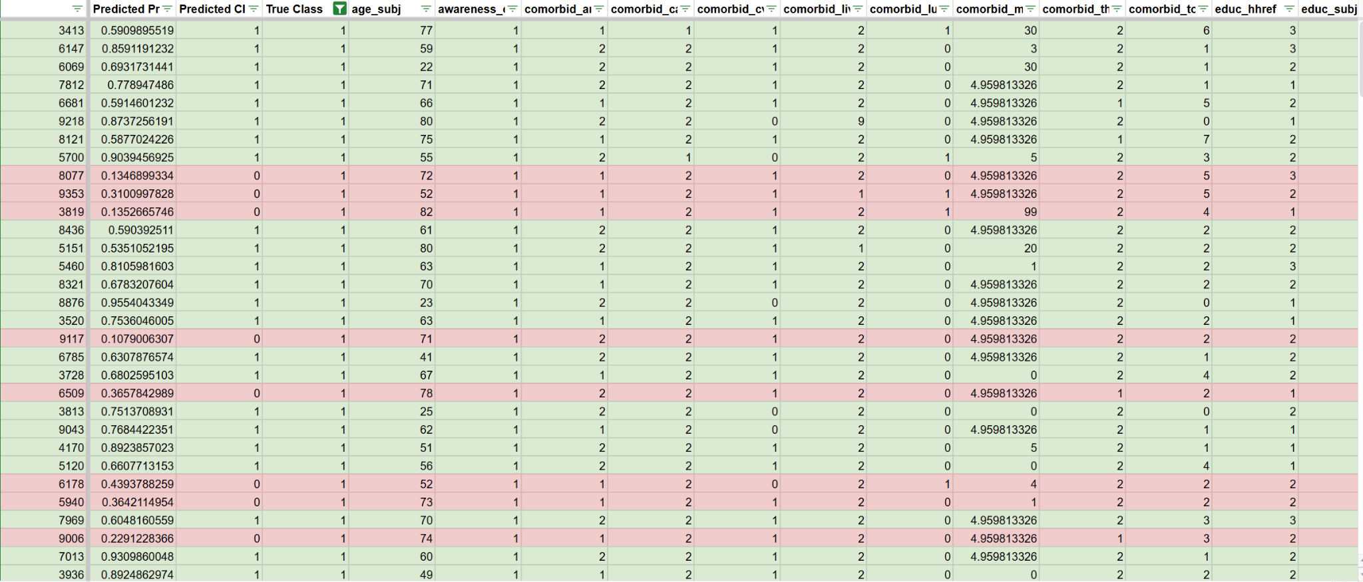
Final Data With Probability
Notes:
SY https://docs.google.com/spreadsheets/d/1A0XUBzh90gztE7UvLgn922T-F6Dkm58nA5nr_fdu_go/edit?gid=363040344#gid=363040344

Slide 37
06
Result
Notes:
Reina write down the notes
Ryan present

Slide 38
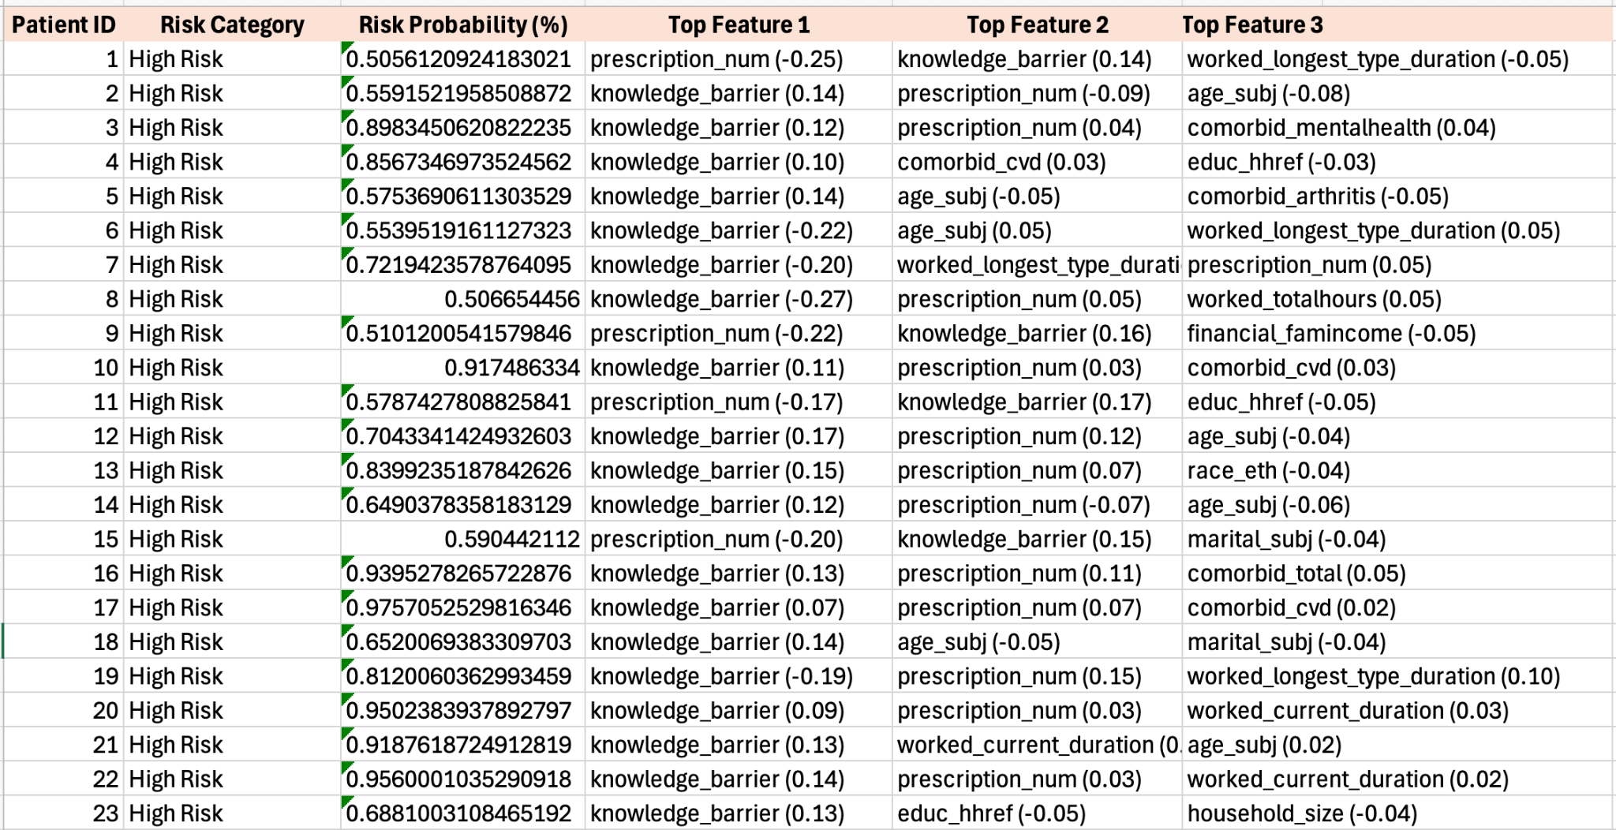
Individual Risk Assessment
Top Features Frequency
Knowledge_barrier
Prescription_num
worked_longest_type_duration
Top Positive Average SHAP Values
worked_totalhours
comorbid_mentalhealth
marital_hhref
Notes:
Reina write down the notes, Ryan present
Notes:
We finally generated the results of our individual risk assessment, showcasing how the predictive model identifies and explains “High Risk” classifications for patients. SHAP values were used to determine the top three features influencing each patient’s classification and to uncover patterns among frequently occurring features. For instance, “knowledge_barrier” was a recurring feature, indicating potential gaps in understanding or access to healthcare. Moreover, when analyzing average SHAP values, “worked_total_hours” was found to significantly increase the likelihood of a “High Risk” classification.
"This slide highlights the top positive average SHAP values, which indicate the most significant features contributing to the risk of detachment from diabetes self-care. ​ The key features include:
Knowledge Barrier: This measures the patient's lack of knowledge about diabetes management, which can significantly impact their ability to manage their condition effectively. ​
Prescription Number: The number of prescriptions a patient has can indicate the complexity of their medical regimen, which may affect their self-care practices. ​
Worked Longest Type Duration: The duration of the longest type of work the patient has done, which can reflect their work stability and stress levels. ​
Worked Total Hours: The total number of hours worked, which can impact the time and energy available for self-care. ​
Comorbid Mental Health: The presence of mental health comorbidities, which can affect motivation and ability to manage diabetes.
Marital Status (marital_hhref): Marital status can influence social support systems, which are crucial for effective diabetes management."

Slide 39
Model Training
Challenges:
Class imbalance: despite efforts using techniques like SMOTE and class weighting, achieving a high f1-score for the minority class (high-risk patients) proved challenging.
Findings:
The bagging ensemble with optimized model weights provided the most balanced results, improving the model's recall for high-risk patients while maintaining reasonable precision.
Next Step:
Explore other oversampling methods such as Adaptive Synthetic Sampling which might create more realistic synthetic samples by considering data density and distribution.
Test other ensemble techniques such as XGBoost which might provide further performance.
Notes:
Reina write down the notes
Ryan present
Although we achieved some results of the model’s prediction for identifying “High Risk” patients, we indeed faced some challenges during the model training process. One major challenge we faced was class imbalance. In our dataset, the minority class, which represent high-risk patients, was underrepresented compared to the majority class. This imbalance made it difficult to achieve a high F1-score. Even after applying techniques like SMOTE to generate synthetic samples and class weighting to assign higher importance o minority class errors, the performance for high-risk predictions remained suboptimal.
One key finding from the model training is that ensemble method provided the most balanced results, significantly improving the model’s ability to identify high-risk patient(recall_ while maintaining a reasonable level of precision.
If we were to move forward with this project in the future, we probably could explore other oversampling techniques and experiment with alternative ensemble techniques. Such as XGBoost which might improve our performance.

Slide 40
Real-World Implications
Model Insights:
Identify patients at risk of unsuccessful diabetes management before it becomes a problem
Imperfect model can still inform healthcare providers on who needs outreach the most.
Identified important risk factors, e.g. working hours and knowledge barriers
Stakeholder Impact:
Healthcare providers: Something is better than nothing - an imperfect tool can still assist with targeted care
Patients: Improved access to resources and engagement with healthcare providers
Public health officials and policymakers: Identify areas where development of public services are most needed
Health insurance companies: Cost savings resulting from improved diabetes management
Researchers: Enhanced understanding of risk and causes of risk when it comes to diabetes management & highlighted opportunities for improved research and data collection.
Notes:
Reina write down the notes
Ryan present
Real-world implications of our model. ​ Model Insights: ​ Even though the model is not perfect, it can still inform healthcare providers about who needs outreach the most. ​ We identified important risk factors, such as working hours and knowledge barriers, which can guide targeted interventions. ​ Stakeholder Impact:
Healthcare Providers: An imperfect tool is better than none; it can assist with targeted care. ​
Patients: Improved access to resources and engagement with healthcare providers. ​
Public Health Officials and Policymakers: The model can help identify areas where public services are most needed. ​
Health Insurance Companies: Potential cost savings from improved diabetes management. ​
Researchers: Enhanced understanding of risk factors and opportunities for improved research and data collection."

Slide 41
RESOURCES (1/2)
Feedtrail. (n.d.). Patient experience quotes. https://www.feedtrail.com/patient-experience-quotes/
Ahmad, F., & Joshi, S. H. (n.d.). Self-Care Practices and Their Role in the Control of Diabetes: A Narrative Review. Cureus, 15(7), e41409. https://doi.org/10.7759/cureus.41409
CDC. (2024a, July 23). National Diabetes Statistics Report. Diabetes. https://www.cdc.gov/diabetes/php/data-research/index.html
CDC. (2024b, September 25). Type 2 Diabetes. Diabetes. https://www.cdc.gov/diabetes/about/about-type-2-diabetes.html
Cleaned NHANES 1988-2018. (2023). [Dataset]. figshare. https://doi.org/10.6084/m9.figshare.21743372.v7
Diabetes. (n.d.). Retrieved December 3, 2024, from https://www.who.int/health-topics/diabetes
Fang, M., Wang, D., Coresh, J., & Selvin, E. (2021). Trends in Diabetes Treatment and Control in U.S. Adults, 1999–2018. New England Journal of Medicine, 384(23), 2219–2228. https://doi.org/10.1056/NEJMsa2032271
Gonzalez, J. S., Tanenbaum, M. L., & Commissariat, P. V. (2016). Psychosocial factors in medication adherence and diabetes self-management: Implications for research and practice. American Psychologist, 71(7), 539–551. https://doi.org/10.1037/a0040388

Slide 42
RESOURCES (2/2)
Nguyen, V. K., Middleton, L. Y. M., Huang, L., Zhao, N., Verly, E., Kvasnicka, J., Sagers, L., Patel, C. J., Colacino, J., & Jolliet, O. (2023). Harmonized US National Health and Nutrition Examination Survey 1988-2018 for high throughput exposome-health discovery. medRxiv, 2023.02.06.23284573. https://doi.org/10.1101/2023.02.06.23284573
NHANES - About the National Health and Nutrition Examination Survey. (2024, June 17). https://www.cdc.gov/nchs/nhanes/about_nhanes.htm
Powers, M. A., Bardsley, J., Cypress, M., Duker, P., Funnell, M. M., Fischl, A. H., Maryniuk, M. D., Siminerio, L., & Vivian, E. (2017). Diabetes Self-management Education and Support in Type 2 Diabetes: A Joint Position Statement of the American Diabetes Association, the American Association of Diabetes Educators, and the Academy of Nutrition and Dietetics. The Diabetes Educator, 43(1), 40–53. https://doi.org/10.1177/0145721716689694

Slide 43
QUESTIONS ?

